Slide 1
Intelligent Document Extraction, Validation & API Platform
AI Engineer Intern Technical Case Study
End-to-End AI Platform for Financial Document Processing

Slide 2
Problem Statement
Problem Statement
Financial documents such as invoices and financial statements are commonly received as PDFs or images with different layouts, tables and reporting periods.
Manual extraction and validation can be:
Time-consuming
Error-prone
Difficult to standardize
Challenging for downstream financial analysis

Slide 3
Objective
Build an end-to-end platform that:
Accepts PDF/JPG/PNG documents
Validates uploaded files
Extracts meaningful information using OCR + AI
Produces structured JSON
Performs financial calculations and reconciliation
Stores processing results persistently
Provides a dashboard and REST API

Slide 4
Requirements & Supported Documents
Document | Key Information
Invoice | Invoice details, parties, line items, subtotal, tax, total
Balance Sheet | Assets, liabilities, equity, periods
Profit and loss | Revenue, expenses, profit/loss, comparative periods
Cash Flow Statement | Operating, investing, financing cash flows, opening/closing cash

Slide 5
Requirements & Supported Documents
Input Support
PDF
JPG
PNG
Maximum 3 pages
File type and Integrity validation
Output
Structured JSON containing:
Metadata
Fields
Tables
Line items
Evidence
Financial validation results
Processing status

Slide 6
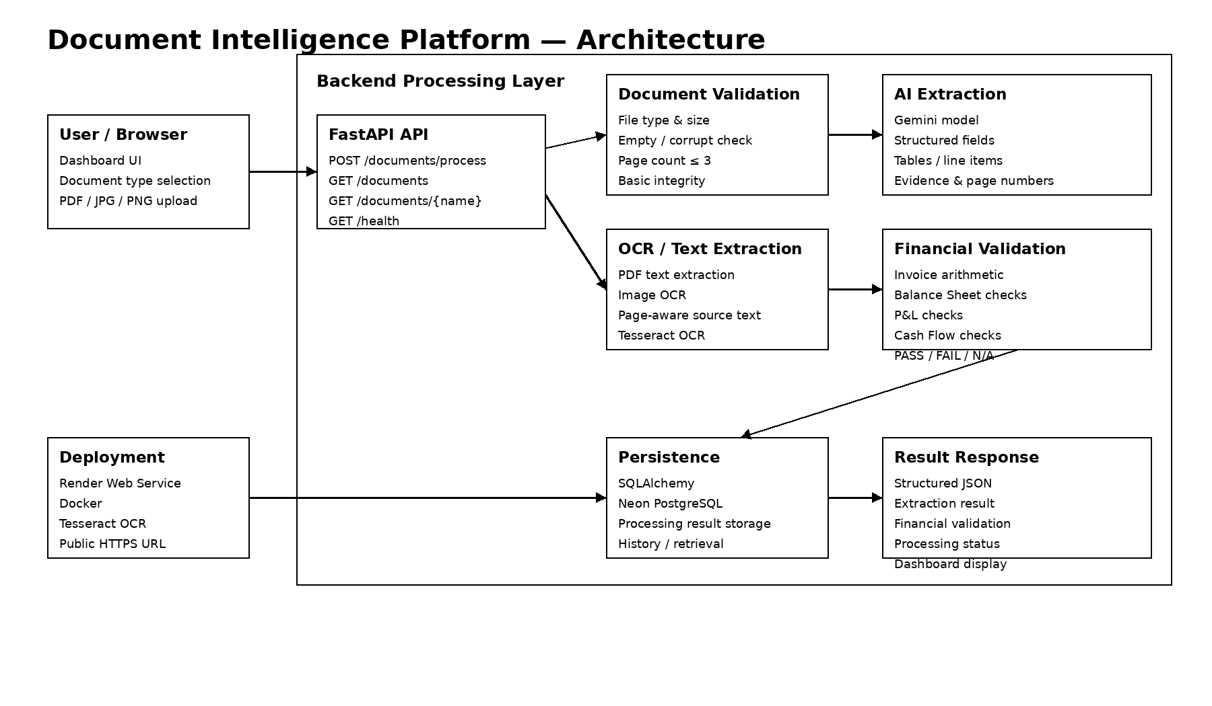
Solution Architecture

Slide 7
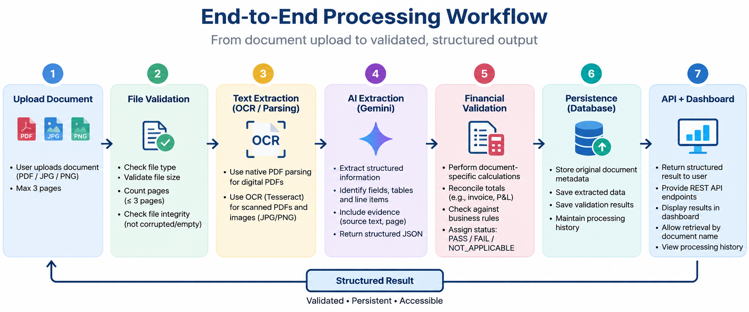
End-to-End Processing Workflow

Slide 8
AI-Based Structured Extraction
Gemini-Based Extraction
The AI extraction layer converts document content into structured data.
Extracted Information
Document metadata
Dates and reporting periods
Parties/entries
Currency
Financial line items
Invoice line items
Tables
Totals and financial values

Slide 9
AI-Based Structured Extraction
Evidence
Each extracted field can retain:
Source text
Page number
Normalized numeric value
Reliability Rules
Missing values -> Null
Unsupported values are not inferred
Extraction and financial validation are separate stages

Slide 10
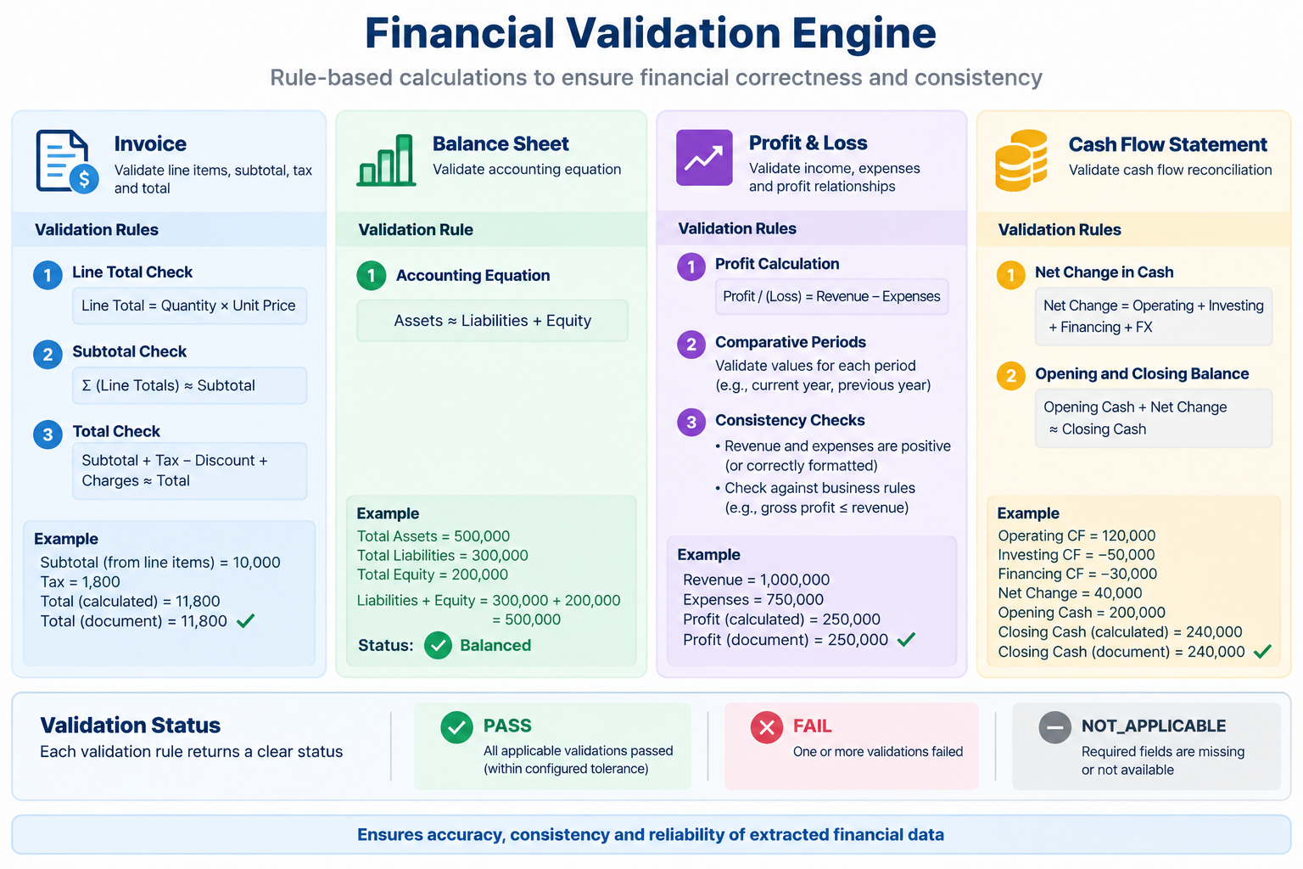
Financial Validation Engine

Slide 11
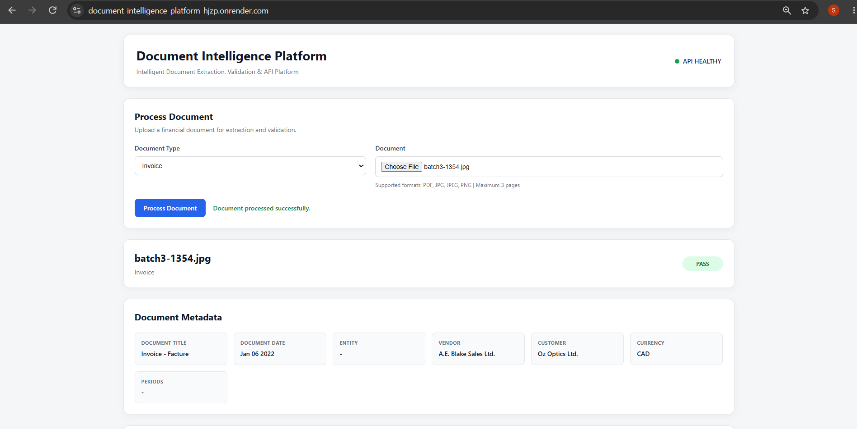
Production Results: All Four Documents
Invoice_production_pass

Slide 12
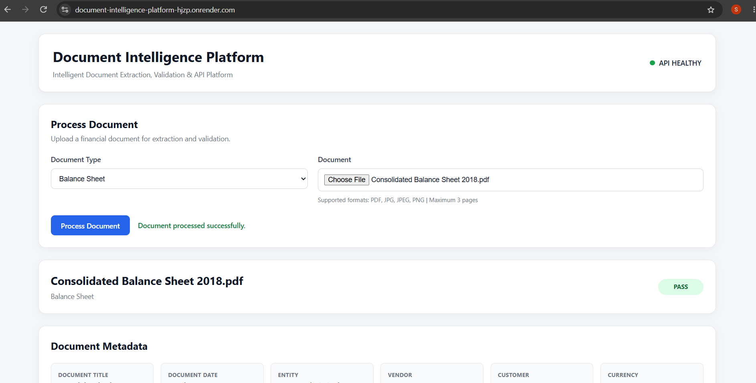
Production Results: All Four Documents
Balance Sheet

Slide 13
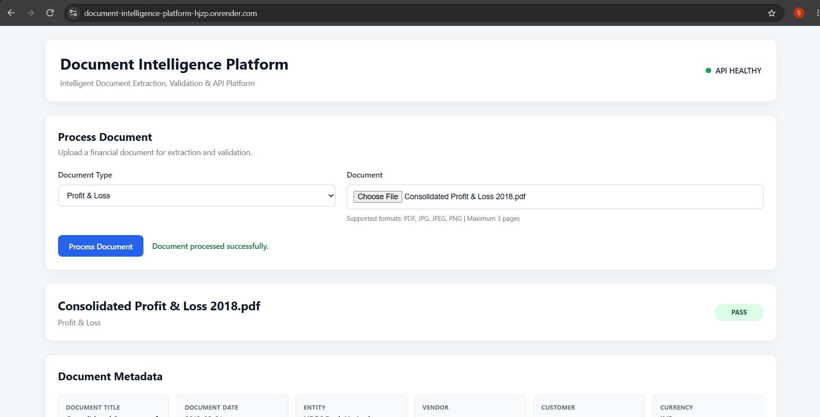
Production Results: All Four Documents
Profit & Loss

Slide 14

Production Results: All Four Documents
Cash Flow Statement

Slide 15
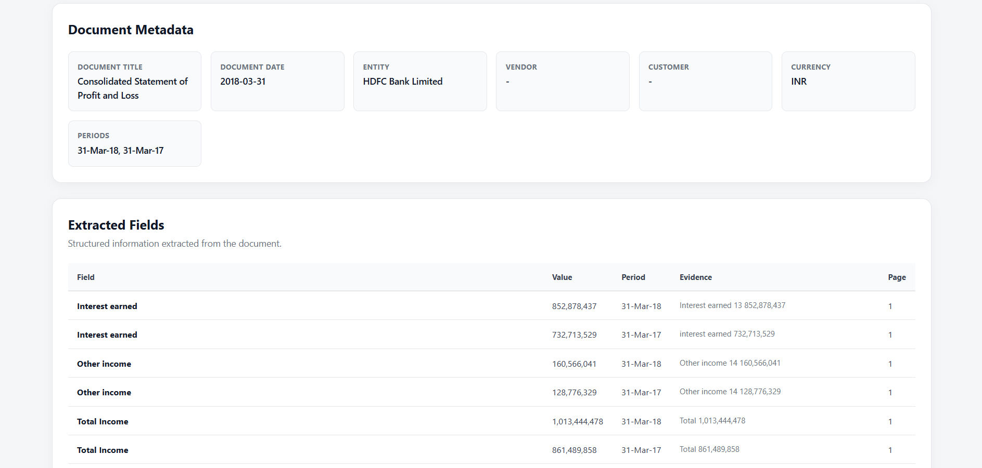
Dashboard, Evidence & Validation
profit_loss_extracted_fields.png

Slide 16
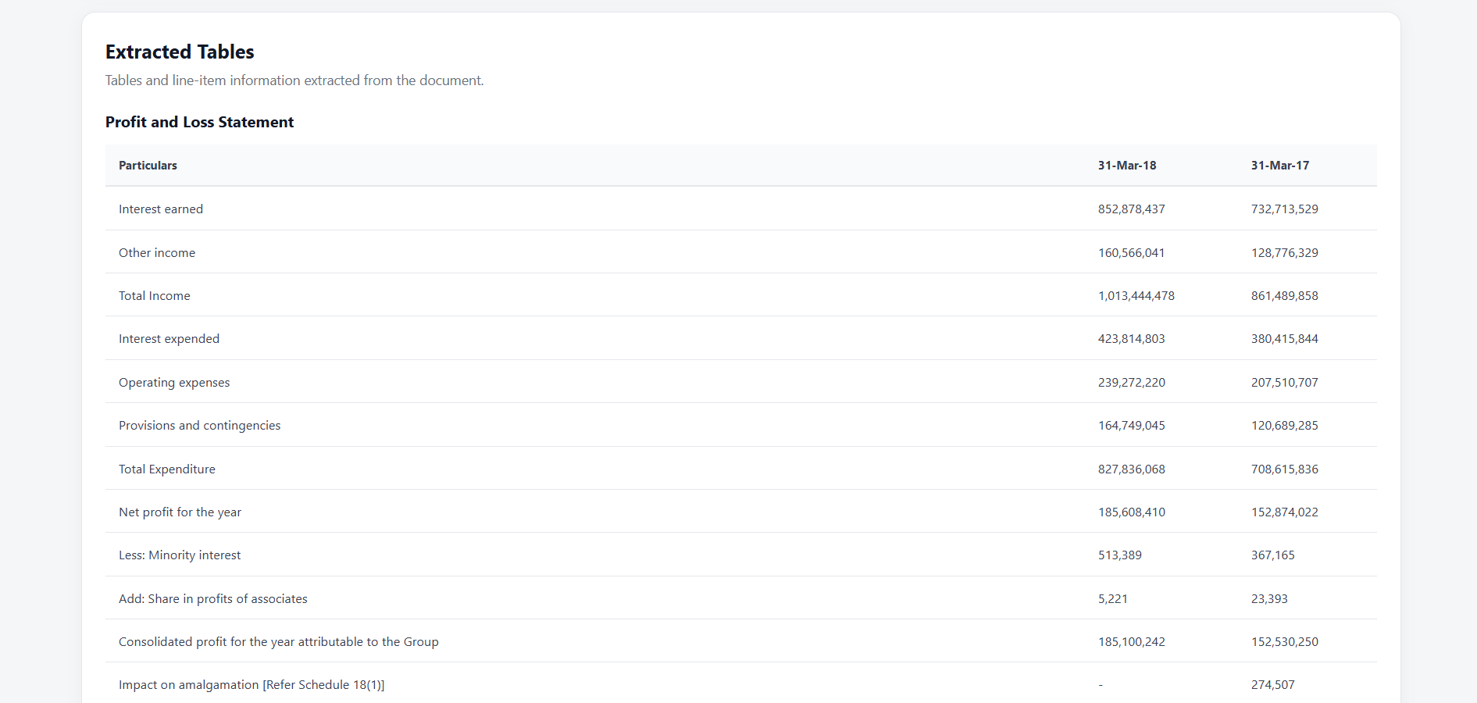
Dashboard, Evidence & Validation
profit_loss_extracted_tables.png

Slide 17
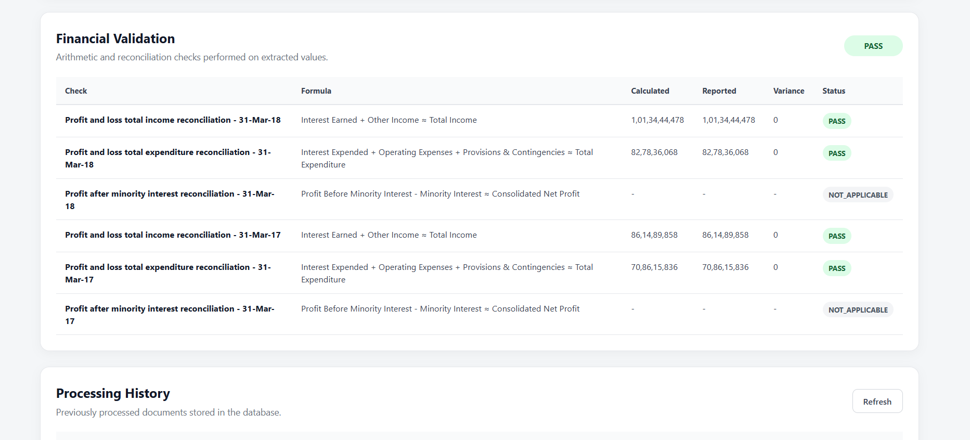
Dashboard, Evidence & Validation
profit_loss_financial_validation.png

Slide 18
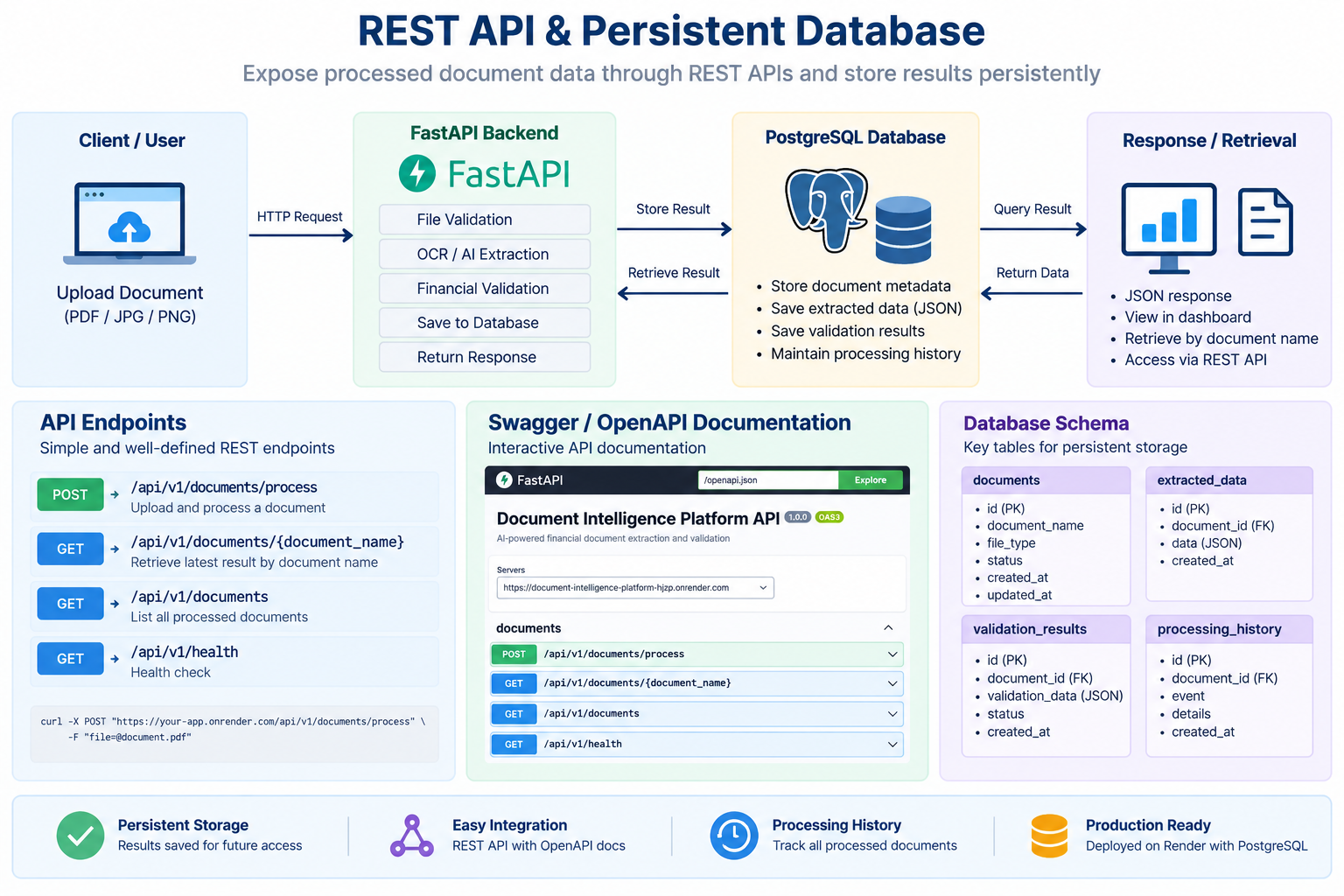

Slide 19
Testing & Reliability
Automated Testing
18 tests passed
3 direct Gemini tests skipped
The skipped tests were due to the Gemini free-tier quota being exhausted.
Testing Areas
File validation
Extraction schemas
OCR
Financial calculations
Database behaviour
Document service
API flow
Real Document Testing
Document | Result
Invoice — batch3-1354 | ✅ PASS
Invoice — batch2-0499 | ❌ FAIL
Balance Sheet | ✅ PASS
Profit & Loss | ✅ PASS
Cash Flow | ✅ PASS

Slide 20
Deployment & Security
Deployment
Dockerized backend
Deployed on Render
Public frontend/dashboard
Public REST API
Swagger/OpenAPI available
PostgreSQL/Neon persistent database
GitHub repository connected to deployment
Security
API keys stored as environment variables
.env excluded from Git
.env.example contains placeholders
Uploaded files excluded from repository
No secrets hardcoded in source code
Production URL:
https://document-intelligence-platform-hjzp.onrender.com

Slide 21
Limitations & Production Improvements
Current Limitations
OCR accuracy can vary with image quality
Complex/unusual layouts may affect extraction
LLM free-tier quotas can restrict requests
Synchronous processing can increase response time
Current system does not automatically classify document type
Production Improvements
Managed OCR / document intelligence services
Multi-provider model routing
Asynchronous processing with queues
Human review for low-confidence extraction
Authentication and role-based access
Rate limiting
Audit trails
Expanded regression dataset
Extraction accuracy monitoring

Slide 22
AI Assistance & Conclusion
AI Assistance
Used AI coding assistance during development.
AI was used for code generation, debugging, documentation, and refinement.
All generated code was reviewed, modified, tested, and integrated manually.
Final implementation and technical decisions were validated through testing and production deployment.
Developer Responsibility
All generated suggestions were:
Reviewed
Modified where required
Tested
Integrated into the final application
Final Outcome
A deployed end-to-end document intelligence platform capable of extracting, validating, storing and exposing structured financial document data through a dashboard and REST API.
Conclusion
End-to-end document intelligence platform successfully implemented.
Supports all four required financial document types.
Provides structured extraction, financial validation, persistent storage, REST APIs, and dashboard visualization.
Deployed publicly with Swagger/OpenAPI documentation.

